Slide 1
ORDBMS Concepts: ADT, Object Tables, and Inheritance
Exploring Object-Relational Database Management Systems

Slide 2
Introduction to ORDBMS
Definition:
ORDBMS is a database management system that combines features of both relational and object-oriented databases.
Key Concepts:
Abstract Data Types (ADT)
Object Tables
Inheritance in Databases

Slide 3
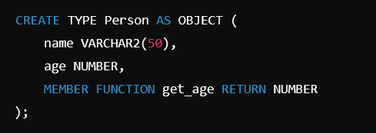
Abstract Data Types (ADT)
ADTs are user-defined types that model real-world entities.
Can include methods and attributes.
Person is an ADT representing an object with a name and age.

Slide 4

Object Tables
Object tables store objects created using ADTs.
Each row is an instance of an object type.
The person_table stores instances of the Person ADT.

Slide 5
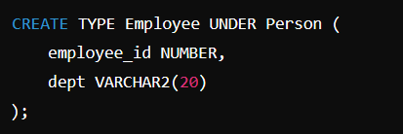
Inheritance in ORDBMS
Inheritance allows objects to inherit attributes and methods from a parent type.
Employee inherits from Person but has additional attributes like employee_id and dept.

Slide 6
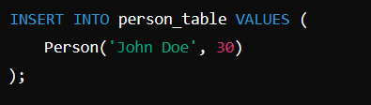
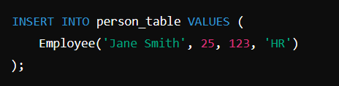
Example Queries

Slide 7
Conclusion
Summary:
ORDBMS blends the best of relational and object-oriented databases by using ADTs, object tables, and inheritance.
Future Learning:
Explore more complex features like nested tables, references, and object views.

